Slide 1


Compute Engine and App Engine

Slide 2



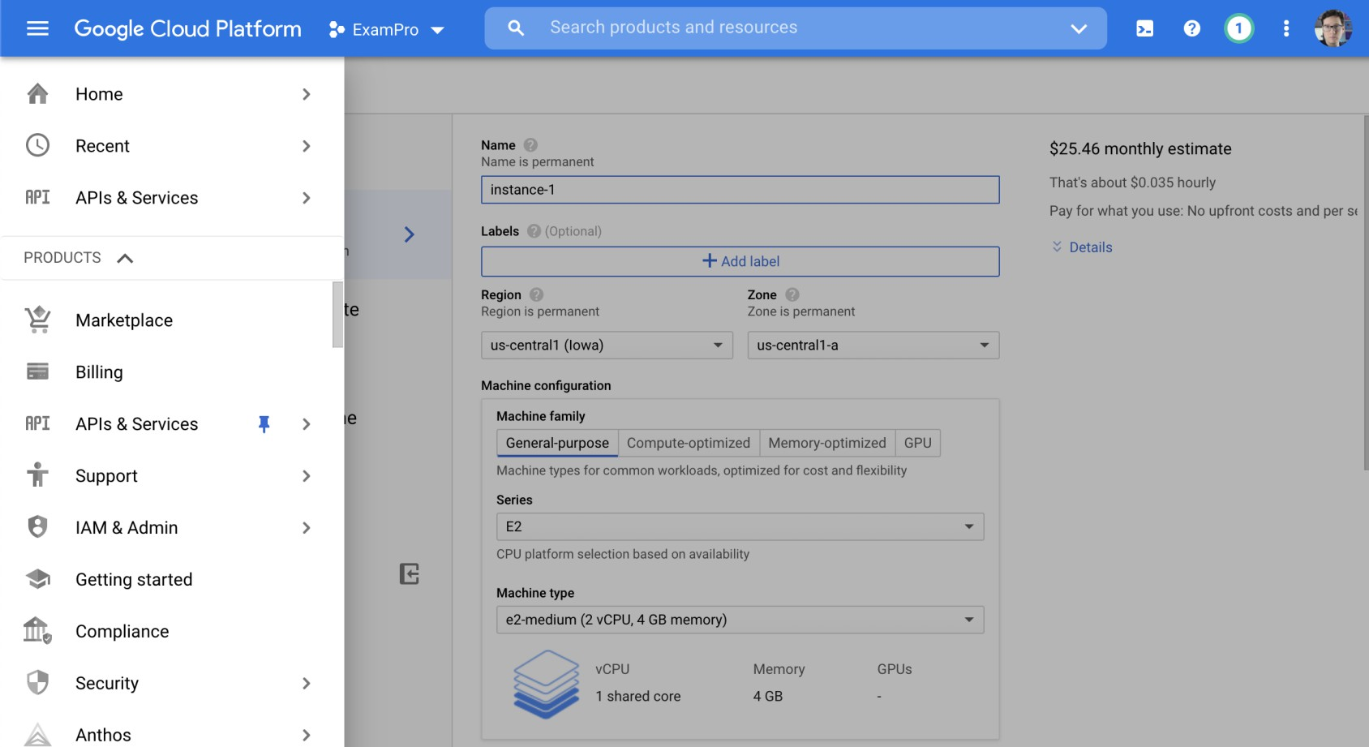
Google Cloud Console - Overview
The Google Cloud Console is a web-based, unified console that provides an alternative to command-line tools. It allows you to build, manage, and monitor everything from simple apps to complex cloud deployments.

Slide 3
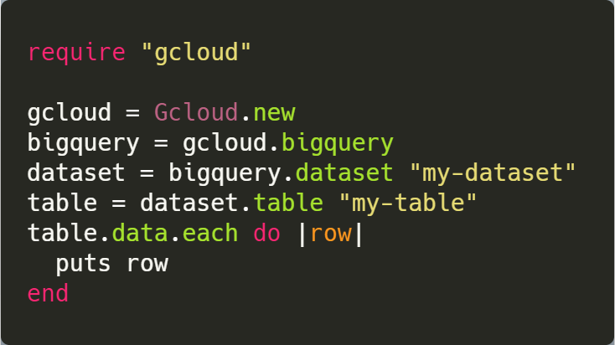
Cloud SDK
A Software Development Kit (SDK) is a collection of development tools bundled together in a single installable package. You can use the Cloud SDK to programmatically create, modify, delete, or interact with Google Cloud resources.
Google Cloud SDK is offered in the following programing languages:
Java
Python
Node.js
Ruby
Go
.NET
PHP

Slide 4
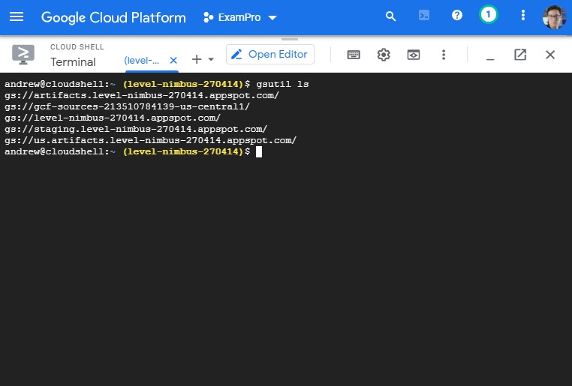
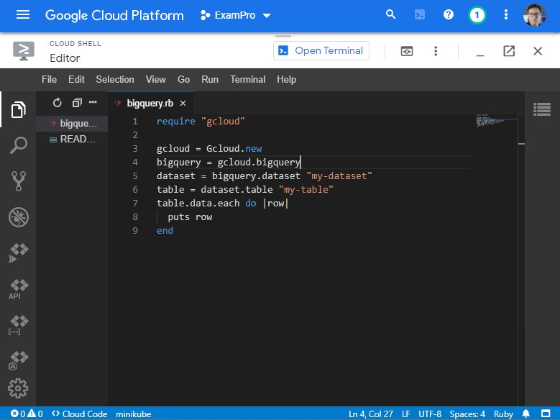
Cloud Shell
Cloud Shell is a free online environment that provides a command-line interface and online code editor for managing your infrastructure and cloud development.

Slide 5
Google Cloud Projects
What is a Project?
A logical container for your cloud resources.
Each resource must belong to a project.
Project Components
Settings
Permissions
Metadata
Project Isolation
Resources within a project are isolated by default.
Use Shared VPC or VPC Network Peering to share resources between projects.
Project Identifiers
Project Name
Project ID
Project Number
Notes:
A Project in Google Cloud is a logical grouping of resources.
A cloud resource must belong to a project
A project is made up of the:
settings
permissions
other metadata
A project can't access another project's resources unless you use Shared VPC or VPC Network Peering.
Resources within a single project can work together easily, for example by communicating through an internal network, subject to the regions- and-zones rules.
Each Google Cloud project has the following:
A project name, which you provide.
A project ID, which you can provide or Google Cloud can provide for you.
A project number, which Google Cloud provides
As you work with Google Cloud, you'll use these identifiers in certain command lines and API calls.

Slide 6
Google Cloud Projects
Using Project Identifiers
Use them in command-line tools and API calls.
Key Points:
Unique Project IDs: Each project has a unique ID that cannot be reused, even if the project is deleted.
Billing Association: When billing is enabled, a project is linked to a single billing account. Multiple projects can share the same billing account.
Resource Namespacing: Each project acts as a namespace, meaning that resources within a project must have unique names. However, you can reuse resource names across different projects.
Notes:
A Project in Google Cloud is a logical grouping of resources.
A cloud resource must belong to a project
A project is made up of the:
settings
permissions
other metadata
A project can't access another project's resources unless you use Shared VPC or VPC Network Peering.
Resources within a single project can work together easily, for example by communicating through an internal network, subject to the regions- and-zones rules.
Each Google Cloud project has the following:
A project name, which you provide.
A project ID, which you can provide or Google Cloud can provide for you.
A project number, which Google Cloud provides
As you work with Google Cloud, you'll use these identifiers in certain command lines and API calls.

Slide 7
Introduction to Compute Engine
Definition: Compute Engine provides virtual machines (VMs) as the backbone of cloud infrastructure.
Features:
Infrastructure as a Service (IaaS).
Flexible configurations for vCPU, memory, storage, and networking.
Supports both Linux and Windows operating systems.
Specialised VMs such as preemptible, spot, and confidential VMs.
Examples: General workloads, web applications, and enterprise systems.

Slide 8
Setting Up a Virtual Machine Instance
Definition: Compute Engine provides virtual machines (VMs) as the backbone of cloud infrastructure.
Features:
Infrastructure as a Service (IaaS).
Flexible configurations for vCPU, memory, storage, and networking.
Supports both Linux and Windows operating systems.
Specialised VMs such as preemptible, spot, and confidential VMs.
Examples: General workloads, web applications, and enterprise systems.

Slide 9
Setting Up a Virtual Machine Instance
Key Steps:
Access: Use the Google Cloud Console, Cloud Shell, or REST API.
Configuration:
  Project, Region, and Zone:
  Select based on workload and latency requirements.
  Machine Type: Choose from predefined or custom types.
  Disks: Persistent (HDD or SSD) or Local SSD for high performance.
  Images: Select public (Linux/Windows) or custom boot disk images.
Networking: Configure subnets, IP allocation, and firewalls.

Slide 10
Customising Machine Types and Disk Options
Machine Families:
General-purpose: Balanced price and performance for most workloads.
Compute-optimized: High performance for compute-intensive tasks.
Memory-optimised: Ideal for in-memory databases like SAP HANA.
Accelerator-optimised: GPU-based tasks like ML training.
Disks:
Persistent Disks: Durable, scalable, and bootable.
Local SSDs: High throughput but ephemeral.
RAM Disks: Temporary but extremely fast storage.

Slide 11
Networking and Firewall Rules Configuration
Networking:
VPC Options: Auto or custom mode.
IP Addresses: Static or ephemeral.
Load Balancing: HTTPS and Network Load Balancers.
Firewall Rules:
Configured by IP address or instance/group tags.
Typical ports:
  SSH (Linux): TCP 22.
  RDP (Windows): TCP 3389.

Slide 12
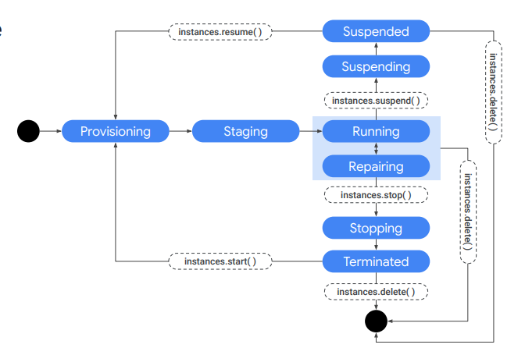
VM Lifecycle in Compute Engine
Notes:
The lifecycle of a VM is represented by different statuses. We will cover this lifecycle on a high level, but we recommend returning to this diagram as a reference.

Slide 13
VM Lifecycle in Compute Engine
Instance Creation and States
Provisioning: Resources (CPU, memory, disks) reserved but VM not running.
Staging:
Resources acquired, system image booted, IP address assigned.
Pre-launch configuration in progress.
Running:
VM active and operational.
Executes startup scripts and enables SSH/RDP access.
Notes:
When you define all the properties of an instance and click Create, the instance enters the provisioning state. Here the resources such as CPU, memory, and disks are being reserved for the instance, but the instance itself isn’t running yet. Next, the instance moves to the staging state where resources have been acquired and the instance is prepared for launch. Specifically, in this state, Compute Engine is adding IP addresses, booting up the system image, and booting up the system. After the instance starts running, it will go through pre-configured startup scripts and enable SSH or RDP access.

Slide 14
VM Lifecycle in Compute Engine
Common Actions During Running State
Live migrate VM to another host for maintenance without rebooting.
Take snapshots of persistent disks.
Export system image or update metadata.
Move VM to a different zone.
Actions Requiring VM Shutdown
Adding more CPU or upgrading machine type.
VM enters a terminated state after shutdown scripts are executed.
Notes:
Now, you can do several things while your instance is running. For example, you can live migrate your virtual machine to another host in the same zone instead of requiring your instance to be rebooted. This allows Google Cloud to perform maintenance that is integral to keeping the infrastructure protected and reliable, without interrupting any of your VMs. While your instance is running, you can also move your VM to a different zone, take a snapshot of the VM’s persistent disk, export the system image, or reconfigure metadata. We will explore some of these tasks in later labs. Some actions require you to stop your virtual machine; for example, if you want to upgrade your machine by adding more CPU. When the instance enters this state, it will go through pre-configured shutdown scripts and end in the terminated state. From this state, you can choose to either restart the instance, which would bring it back to its provisioning state, or delete it

Slide 15
VM Lifecycle in Compute Engine
Other VM States
Reset: Clears memory and resets VM to its initial state while remaining active.
Repairing:
  Triggered by internal errors or unavailable underlying hardware.
  VM is unusable and not billed during repairs.
  Not covered by SLA.
Suspending:
  Enters a suspending state before being fully suspended.
  Can resume or delete later.
Notes:
You also have the option to reset a VM, which is similar to pressing the reset button on your computer. This actions wipes the memory contents of the machine and resets the virtual machine to its initial state. The instance remains in the running state through the reset. The VM may also enter a repairing state. Repairing occurs when the VM encounters an internal error or the underlying machine is unavailable due to maintenance. During this time, the VM is unusable. You are not billed when a VM is in repair. VMs are not covered by the Service level agreement (SLA) while they are in repair. If repair succeeds, the VM returns to one of the above states. Finally, when you suspend the VM, it enters in the suspending state, before being suspended. You can then resume the VM or delete it.

Slide 16
Hands on 1 – Launch and Connect to a VM Instance.
Notes:
Steps:
Create a VM using Google Cloud Console.
Choose an OS image and disk configuration.
Set up SSH or RDP access:
Linux: Use SSH keys via the Cloud Console.
Windows: Configure RDP access with credentials.
Validate connection by accessing the VM.

Slide 17
App Engine
Definition: A serverless application platform for building, deploying, and scaling apps effortlessly.
Why Use App Engine?
Eliminates the need for server management.
Focus on code development.
Supports multiple programming languages (Python, Java, Node.js, Ruby, PHP, Go, etc.).
Common Use Cases:
Rapid prototyping and development
Scalable web applications
APIs for mobile and web

Slide 18
App Engine Architecture
How It Works:
Receives user requests through HTTPS.
Routes requests to the appropriate app version or instance.
Scales automatically based on demand.
Core Features:
Autoscaling: Adjusts the number of instances dynamically.
Integrated developer tools: Debugging, monitoring, and CI/CD pipelines.
Built-in security: TLS, Identity-Aware Proxy, and more.
Environment Components:
Application instances
Datastore integration
Load balancing and scaling

Slide 19
Standard vs. Flexible Environments
 | Standard Environment | Flexible Environment
Key Characteristics | Supports limited languages and runtimes. Sandboxed environment for security. Automatic scaling with quick startup times. | Allows custom Docker containers. Runs on Compute Engine VMs. Access to more system resources.
Ideal For | Low-latency applications. Apps requiring fast response times. | Applications needing specific runtime configurations. Long-running applications.

Slide 20
Standard vs. Flexible Environments
Feature | Standard Environment | Flexible Environment
Scalability | High | Moderate
Runtime Options | Fixed | Customisable
Startup Time | Fast | Slower

Slide 21
Deploying an Application on App Engine
Pre-Requisites:
Google Cloud Platform account
Installed Google Cloud SDK
Basic app (e.g., Flask, Express)
Steps to Deploy:
Setup the Environment:
  Create a GCP project.
  Enable the App Engine API.
Prepare the Code:
  Write or use a simple app (e.g., Flask in Python).
  Add an ‘app.yaml’ configuration file.
Deploy:
  Run ‘gcloud app deploy’.
  Verify the deployment URL in the GCP console.

Slide 22
Hands on 1 – Deploy a Simple Web App

Slide 23
Thank You!

